Slide 1
III. Sponsor demo
Márton Lőrinczi
14.07.2017

Slide 2
What will be in this demo?
Some infos about myself
What have I learnt in the past 3 weeks, and most memoreable parts for me.

Slide 3
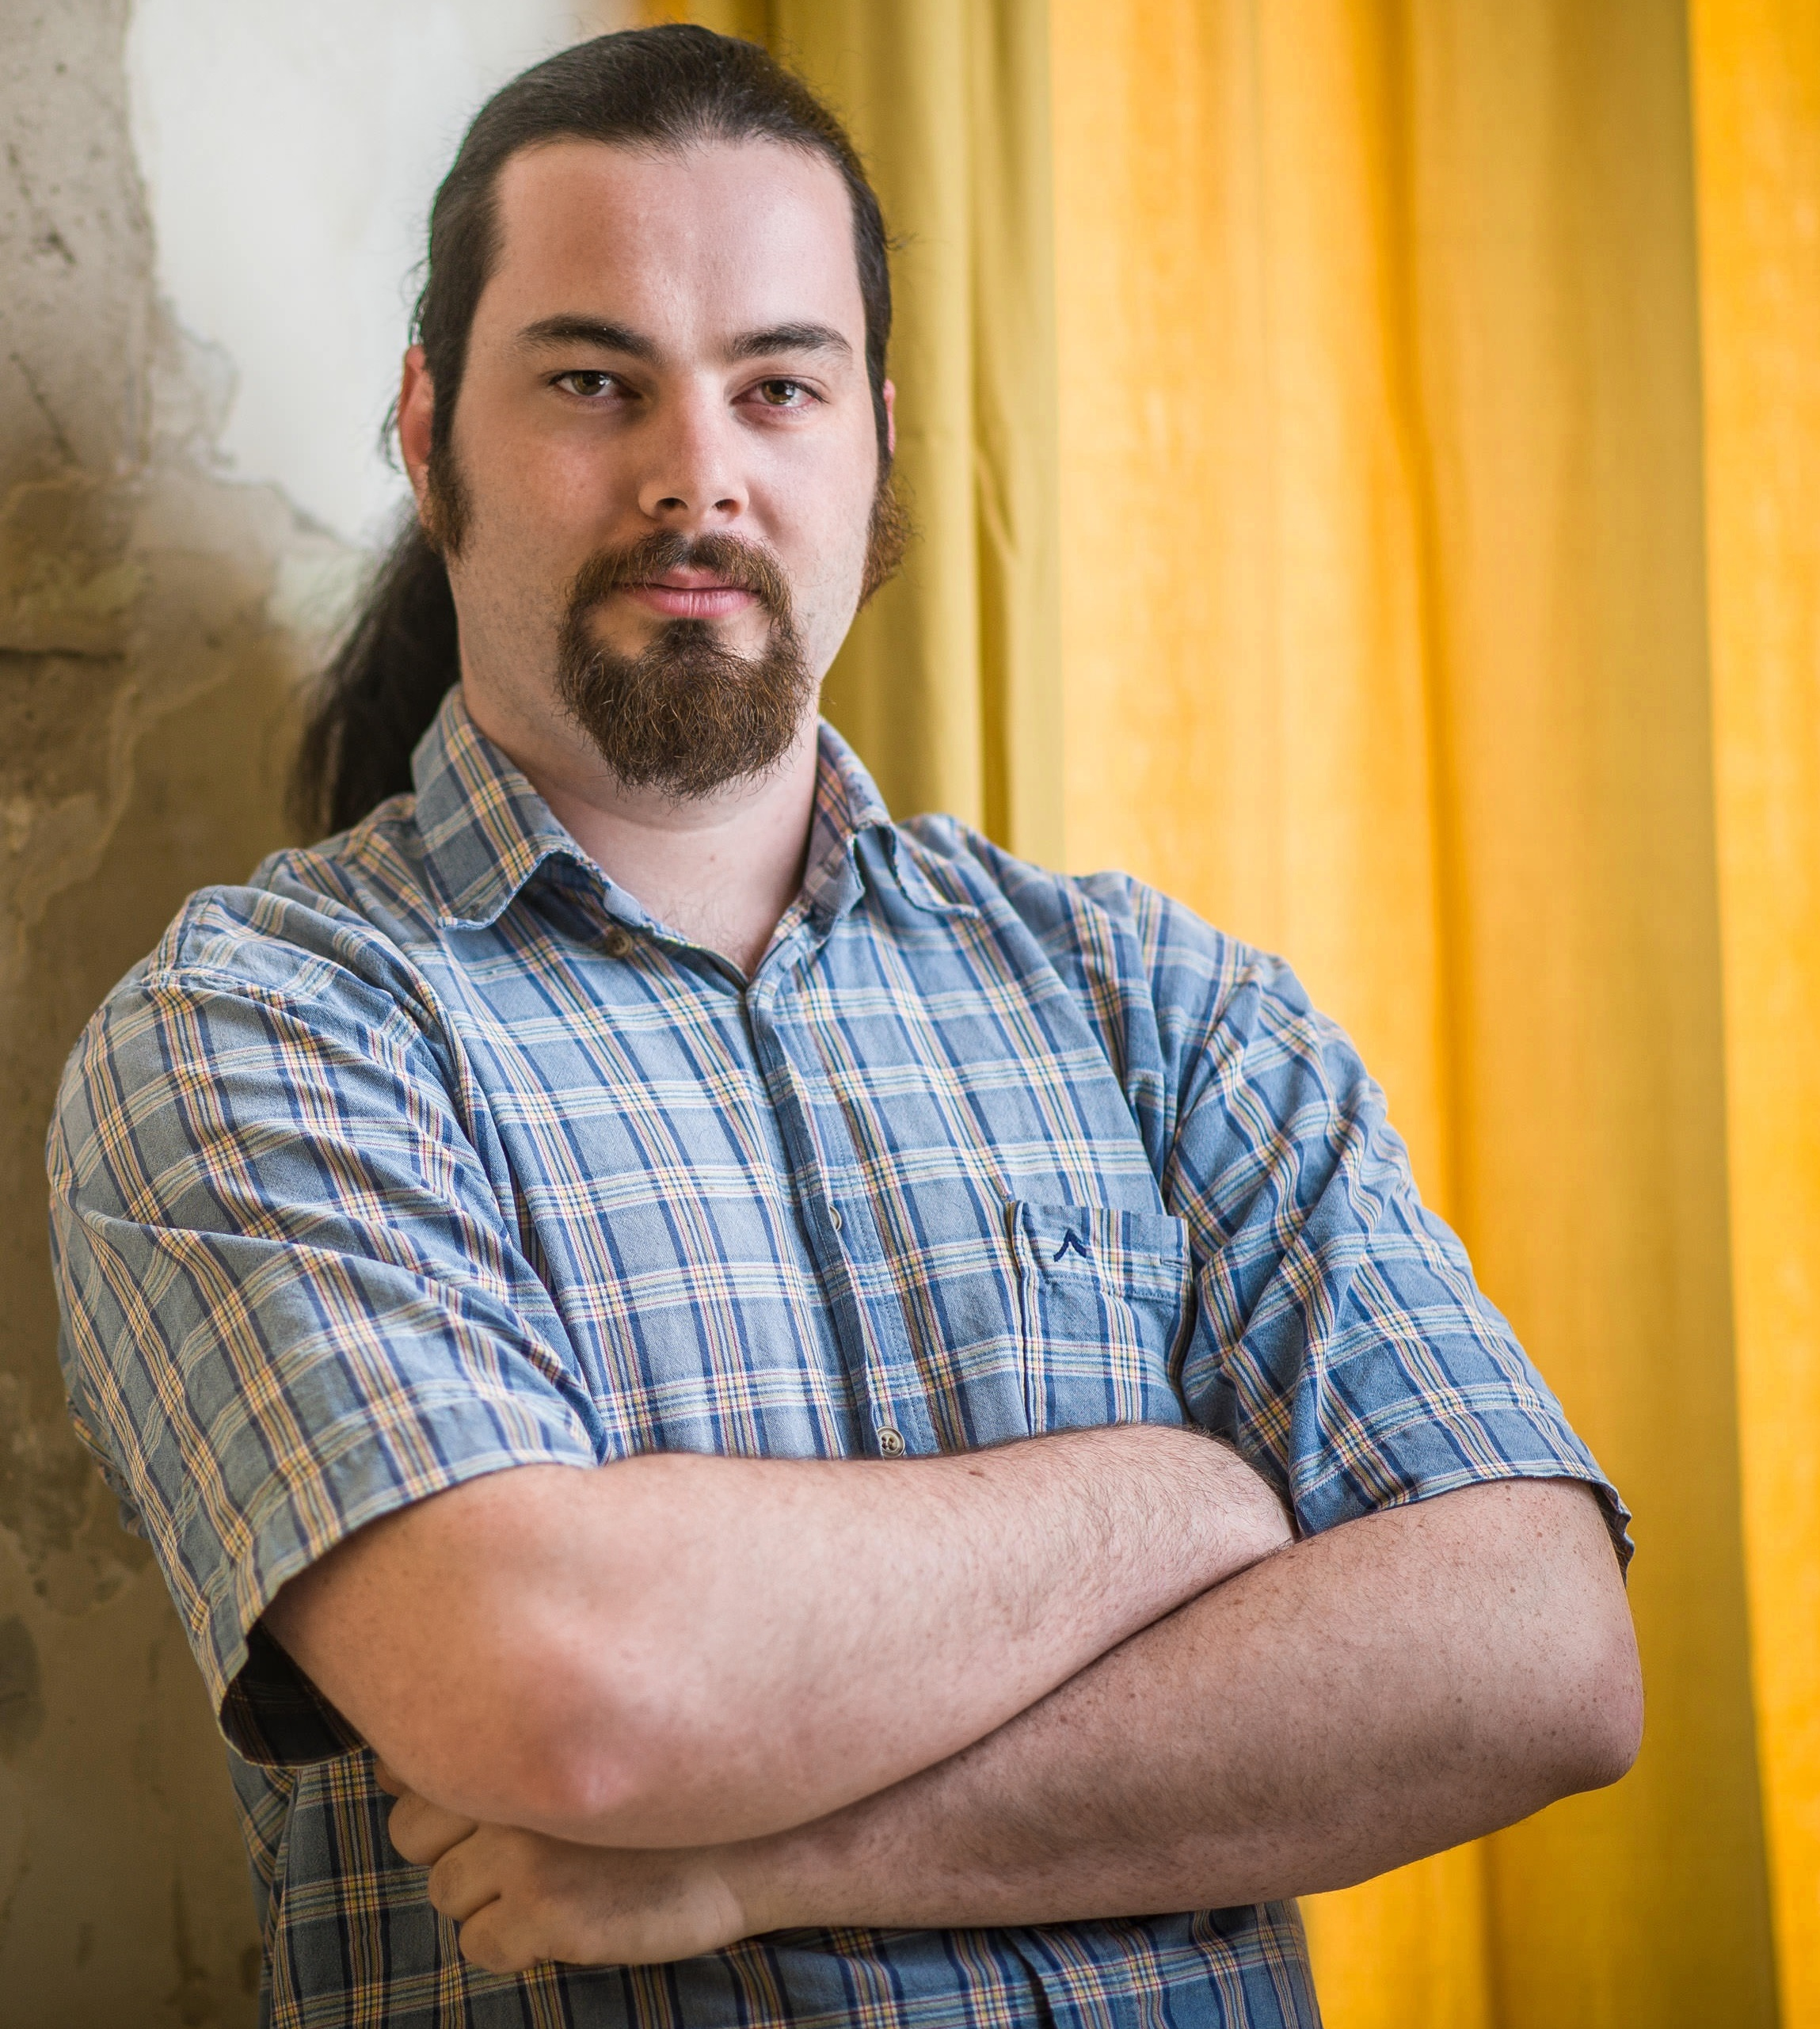
Some infos about myself
Name: Márton Lőrinczi
Age: 26
Studied: Mechanical engineering
Hobbies: DIY projects, Waterpipe

Slide 4
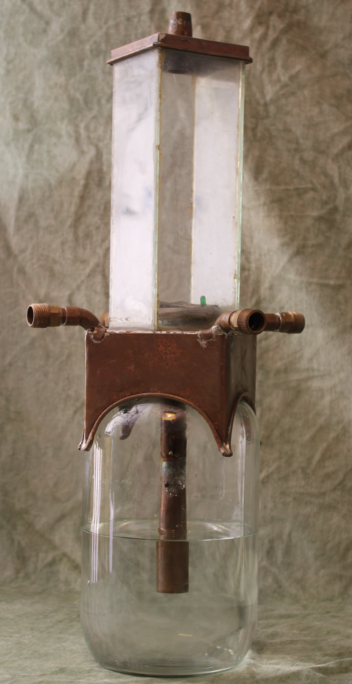
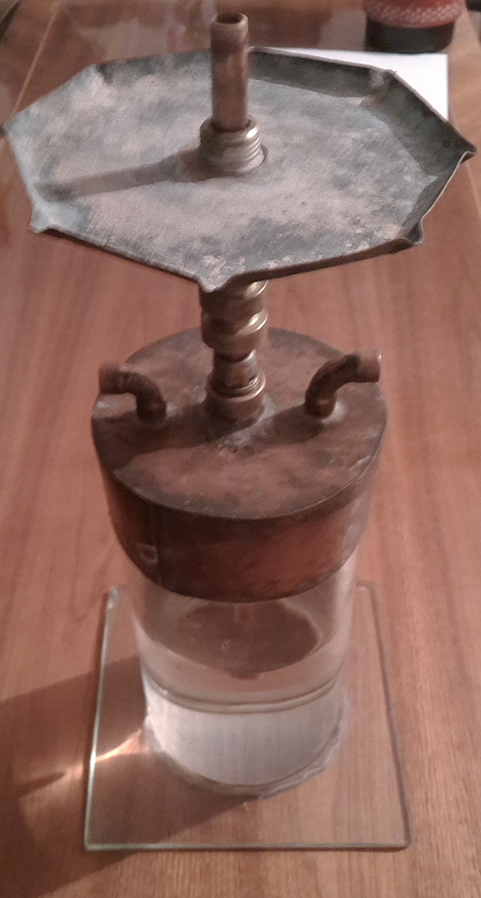
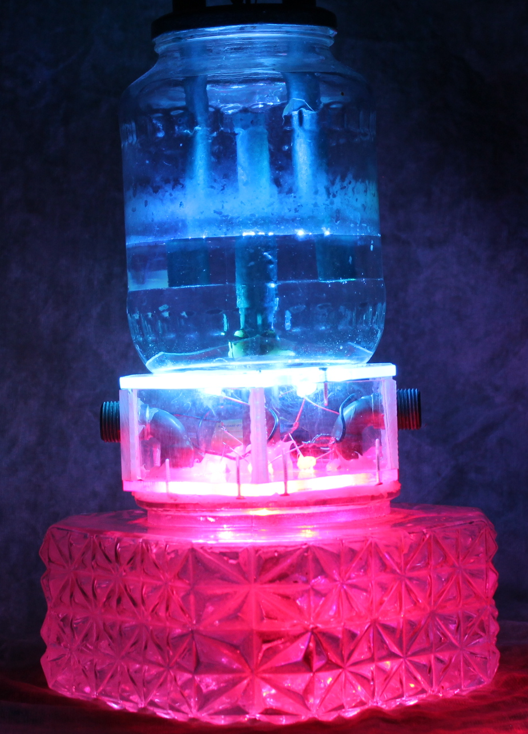
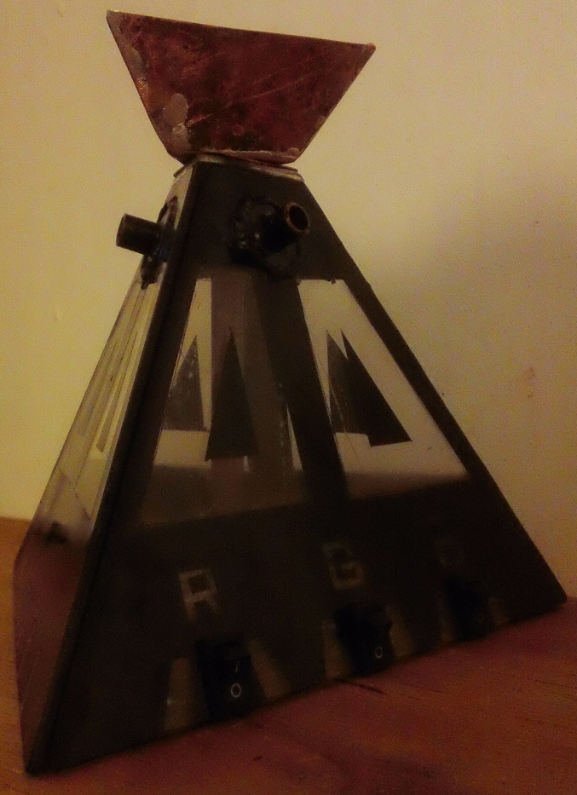
Examples for hobby projects
Hookahs / Waterpipes

Slide 5
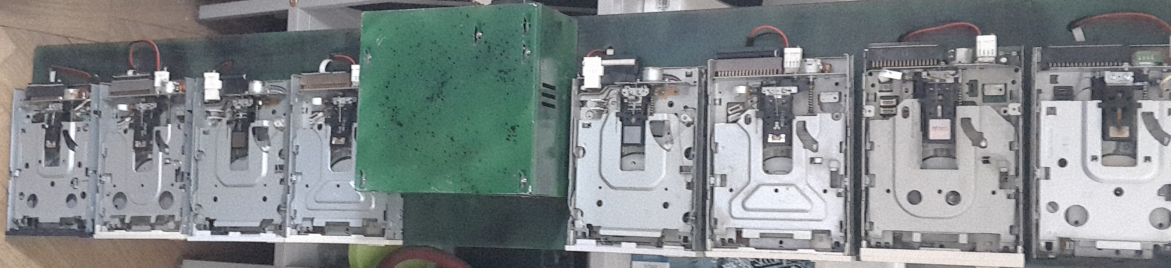
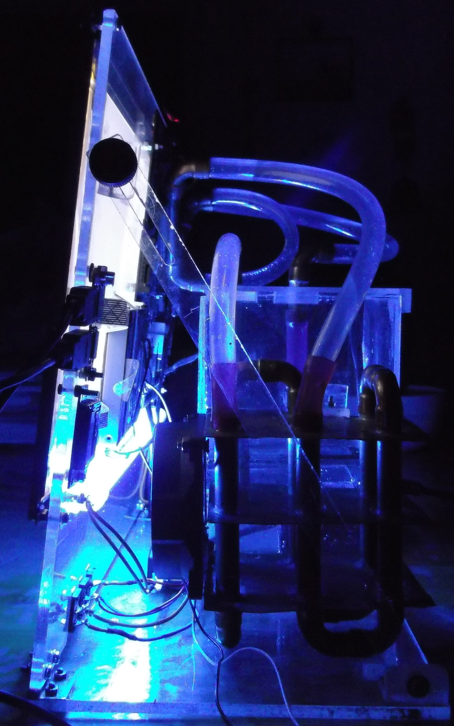
Examples for hobby projects
Watercooled Laptop
Musical floppy drives

Slide 6
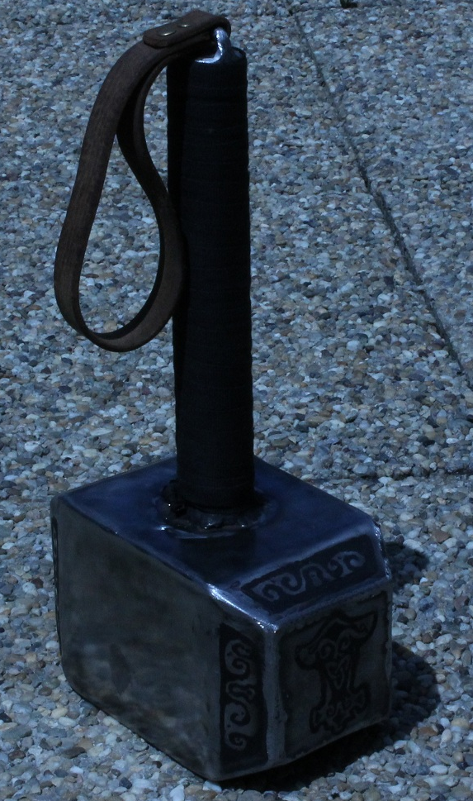
Examples for hobby projects

Slide 7
What have I learnt in the past 3 weeks
Socket server and client
Project - Totorochat
Multitasking
Project – Graphic Chat
Fedexday
Project - HDD Clock
Mutex and message queue
Project – LED Matrix

Slide 8
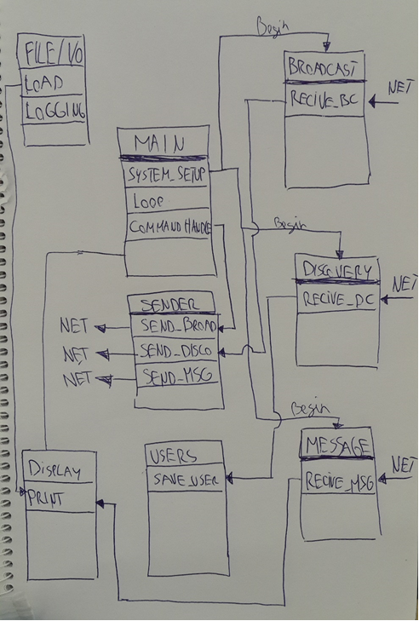
Totorochat
3 Socket server
3 Type of messages
Never use broadcast message in While(1) loop !

Slide 9
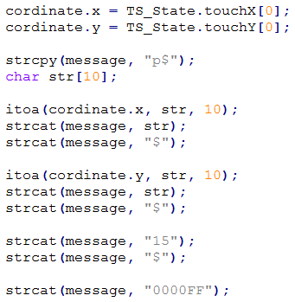
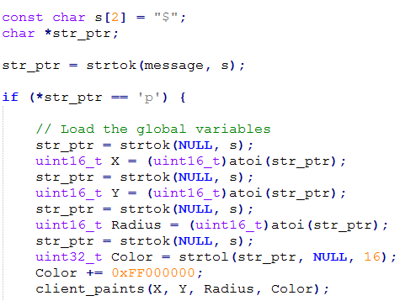
Graphic chat
How to send / receive a struct via TCP ?
Send
Recive

Slide 10
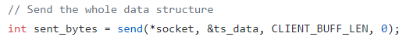

Graphic chat
Or just send it.
And receive it.

Slide 11
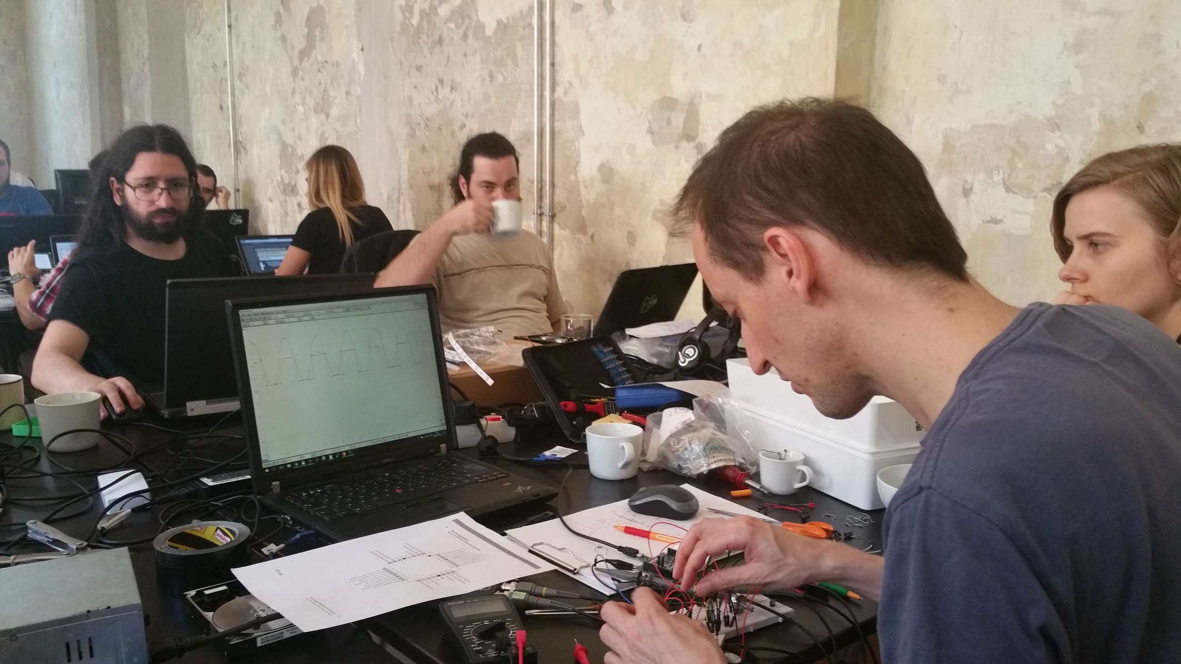
HDD - Clock
Working in team is funny ☺

Slide 12
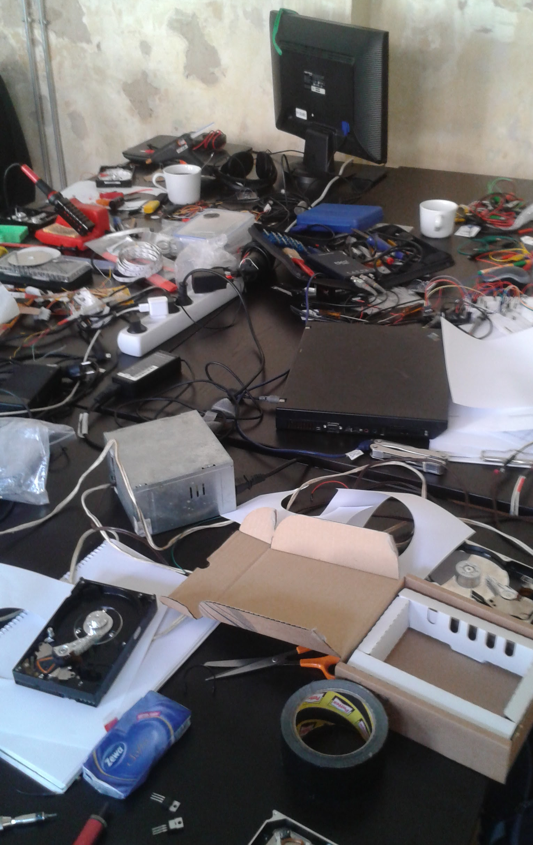
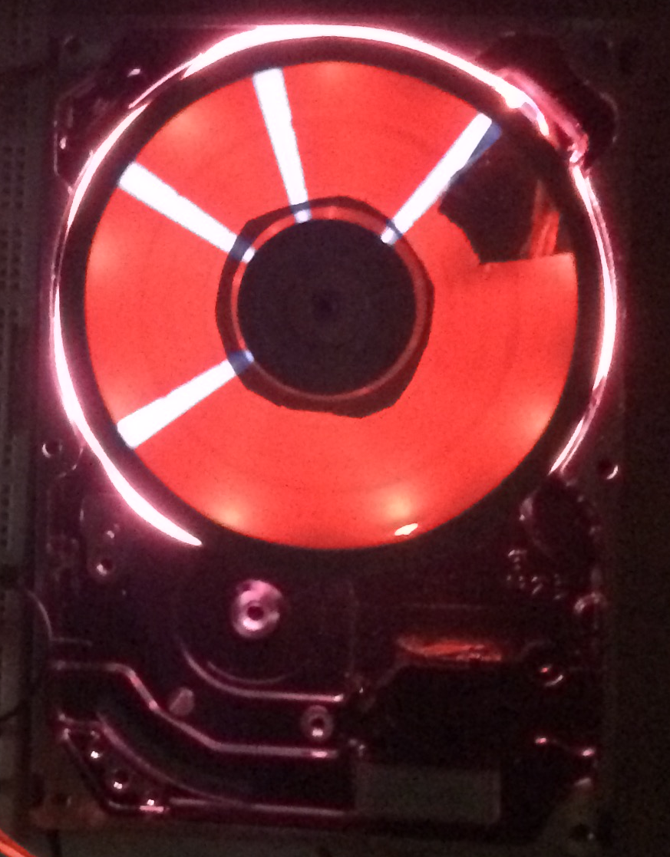
HDD - Clock
Table can be a little bit messy.
At the end we achived half sucsess.

Slide 13
LCD – LED Matrix
Touchscreen [Row][Col]
X cordinate
Y cordinate
ON/OFF
LED [Row][Col]
Board_pin
ON/OFF
LCD Screen
LED Matrix

Slide 14
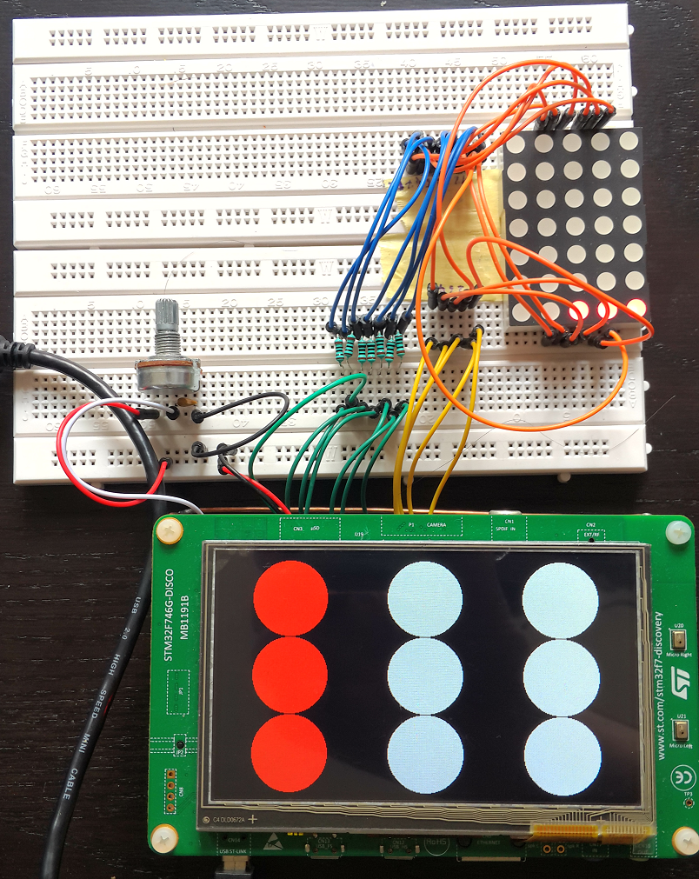
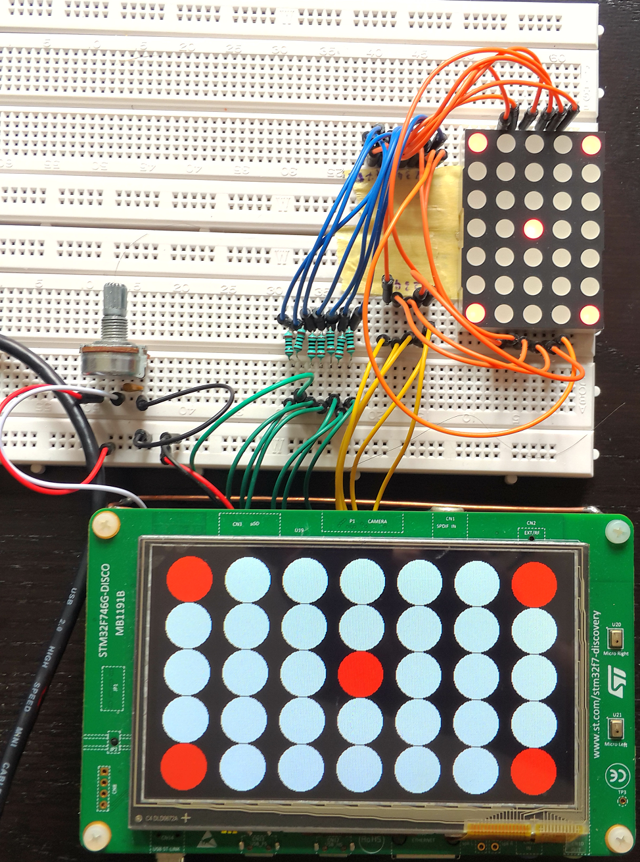
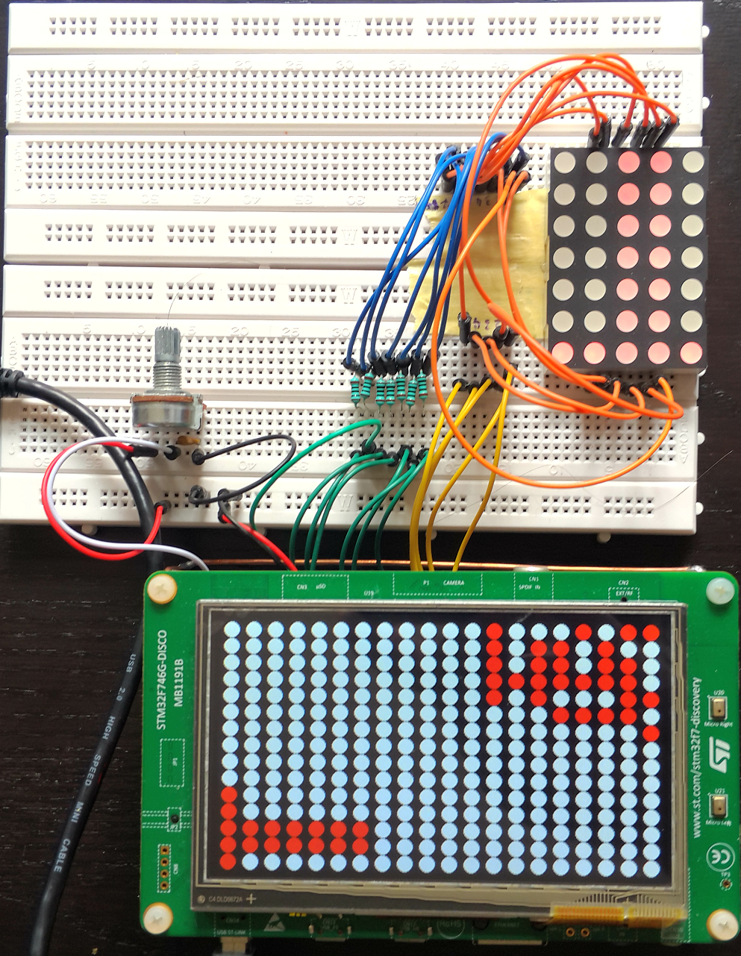
Dynamically changeable Matrix

Slide 15
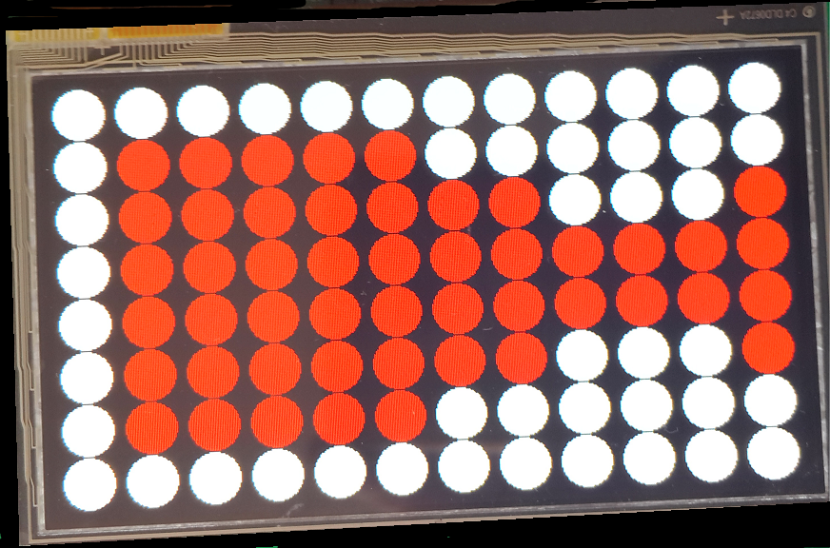
Spritz time

